Slide 1
WORD FREQUENCY COUNT APPLICATION
Under Guidance of
Mr. G. Soma Sekhar

Slide 2
Group Members
K. SUDHARSAN REDDY- 170030689
B. GANESH BABU - 170030120
P. SOBHANA - 170031015
U. MAHESH - 170031326

Slide 3
Abstract
The aim of this project is meant for creating an AVL tree application that uses a tree structure containing all of the words in a document, with a count of the number of times each word is used. Each entry in the AVL tree contains a word from the document and a pointer to an integer that contains a count of the number of times the word appears in the document.
The project mainly consists of the different functions mentioned below, they are:
Counts the words in a file, reads file and creates AVL tree containing list of all words used in the file with count of the number of times each word is found in the file, Reads one word from file, compares two integers identified by pointers to integers, Prints the list with the count for each word, Prints one word from the list with its count.

Slide 4
Introduction on AVL TREES
The AVL tree was introduced in the year of 1962 by G.M. Adelson-Velsky and E.M. Landis.
AVL tree is a self balanced binary search tree.
AVL trees are height balancing binary search tree.
A binary tree is said to be balanced, if the difference between the heights of left and right subtrees of every node in the tree is either -1, 0 or +1.
In an AVL tree, every node maintains a extra information known as balance factor
Balance factor = height Of Left Subtree – height Of Right Subtree

Slide 5
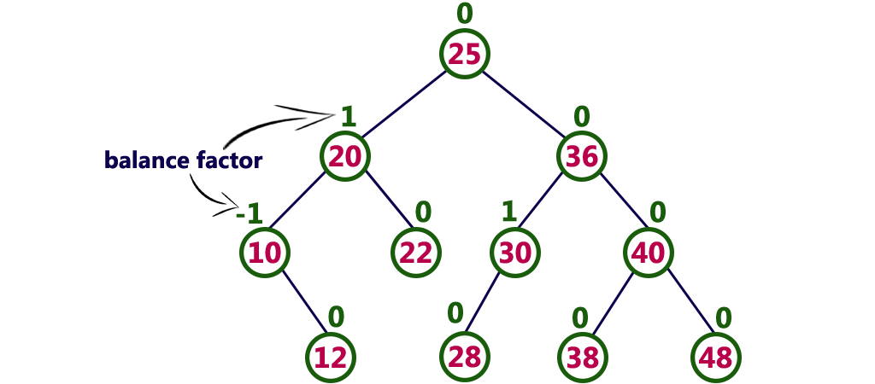
Every AVL Tree is a binary search tree but all the Binary Search Trees need not to be AVL trees.
The above tree is a binary search tree and every node is satisfying balance factor condition. So this tree is said to be an AVL tree.

Slide 6
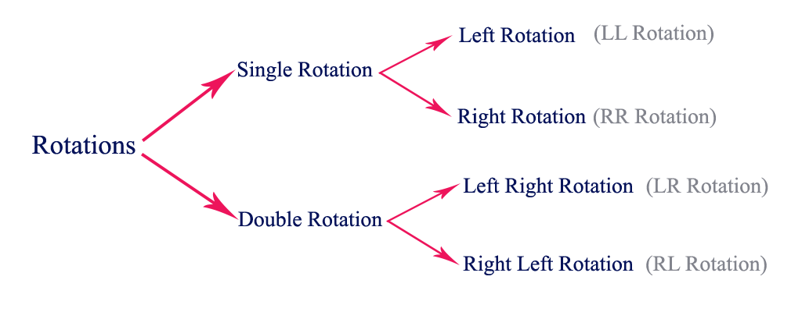
AVL Tree Rotations
Rotation is the process of moving the nodes to either left or right to make tree balanced.

Slide 7
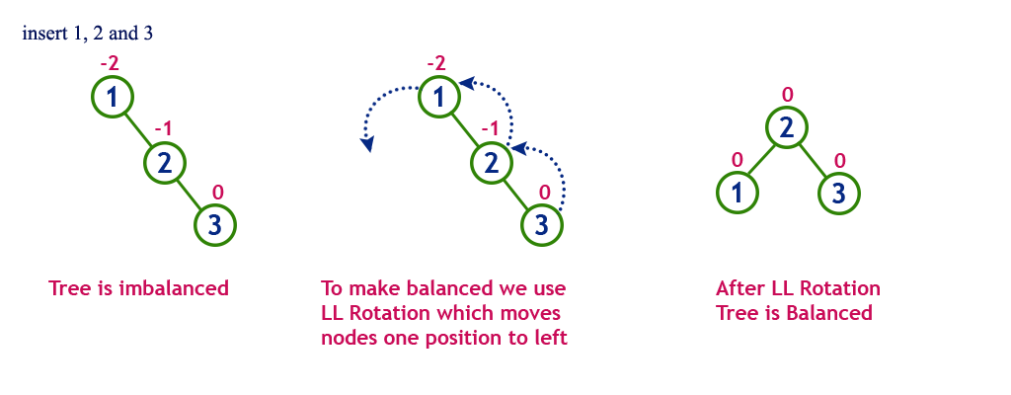
Single Left Rotation (LL Rotation)

Slide 8
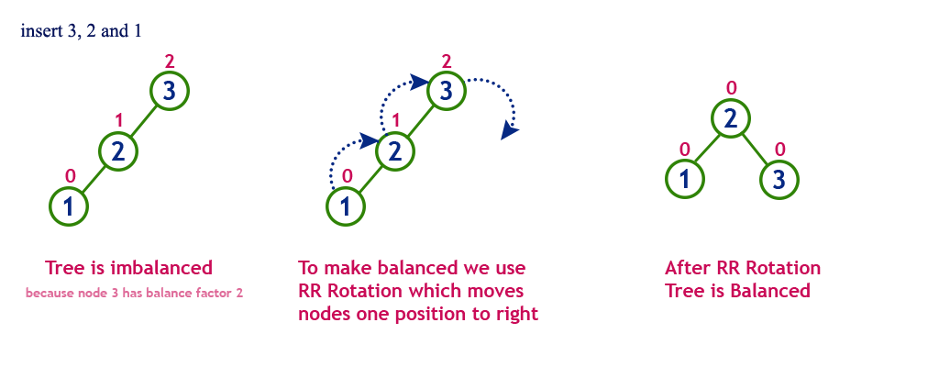
Single Right Rotation (RR Rotation)

Slide 9
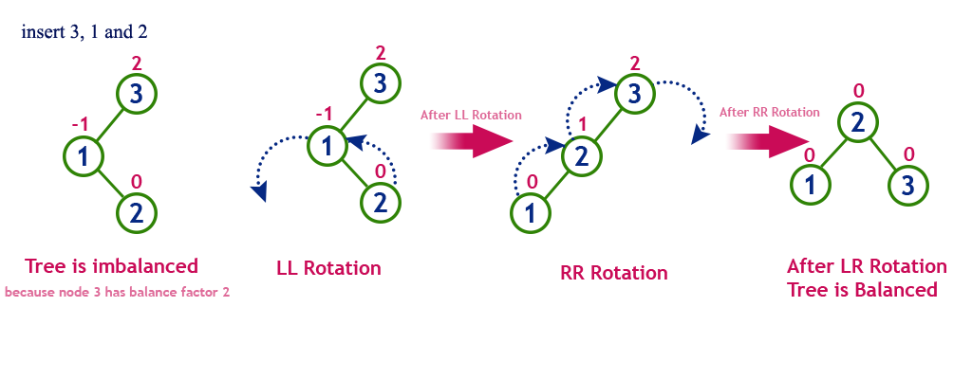
Left Right Rotation (LR Rotation)

Slide 10
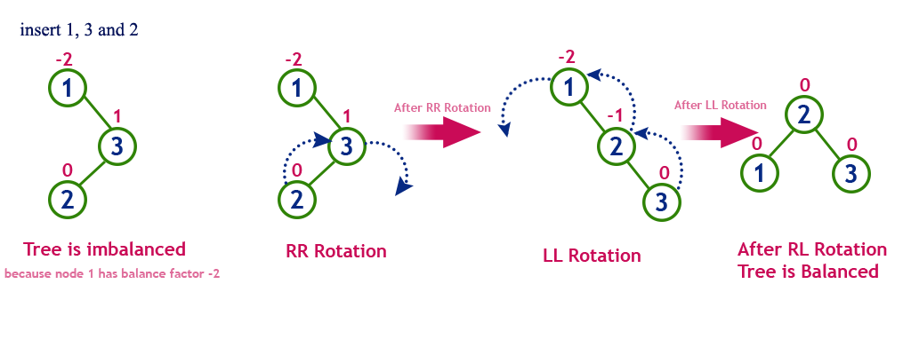
Right Left Rotation (RL Rotation)

Slide 11
Modules
1. Program: counts the words in a file.
2. Function: Reads file and creates AVL tree containing list of all words used in the file with count of the number of times each word is found in the file.
3. Function: Reads one word from file.
4. Function: compares two integers identified by pointers to integers.
5. Function: Prints the list with the count for each word.
6. Function: Prints one word from the list with its count.

Slide 12
Counts the words in a file
Int count(char s[],char word[]) {
char temp[1000]="";
Int j=0,c=0;
Int i;
For(i=0;s[i]!='\0';i++) {
if(s[i]==' '||s[i]=='\0'){
Temp[i]='\0';
If(strcmp(word,temp)==0)
C++;
J=0;
}
Else{
Temp[j]=s[i];
J++;
}
}
Return c;
}

Slide 13
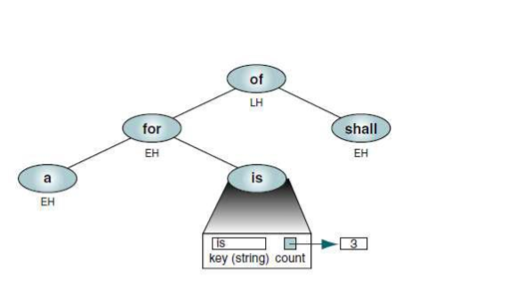
Reads file and creates AVL tree containing list of all words used in the file with count of the number of times each word is found in the file.

Slide 14
code
case 1:{
fptr=fopen("C:\Users\umahe\Desktop\skills33.txt","r");
while(!feof(fptr)){
fgets(s,1000,fptr);
}
int j=0,ctr=0;
int i;
for(i=0;s[i]!='\0';i++) {
if(s[i]==' ') {
temp[ctr][j]='\0';
ctr++;
j=0;
}
else {
temp[ctr][j]=s[i];
j++;
}
}

Slide 15
for(i=0;i<ctr;i++) {
int c=count(s,temp[i]);
root=insert(root,temp[i],c);
}
printf("Data in file is \"%s\"\n",s);
printf("AVL tree is created\n");
printf("Go to function 5 to check whether AVL tree is created or not\n");
break;
}

Slide 16
struct Node* insert(struct Node* node, char *s,int count) {
if (node==NULL)
return(newNode(s,count));
if (strcmp(s,node->s)<0)
node->left=insert(node->left,s,count);
else if (strcmp(s,node->s)>0)
node->right=insert(node->right,s,count);
else return node;
node->height=1+ max(height(node->left),height(node->right));
int balance=getBalance(node);
if(balance>1&&strcmp(s,node->left->s)<0)
return rightRotate(node);
if(balance<-1&&strcmp(s,node->right->s)>0)
return leftRotate(node);
if(balance>1&&strcmp(s,node->left->s)>0) {
node->left=leftRotate(node->left);
return rightRotate(node);
}
if(balance<-1&&strcmp(s,node->right->s)<0) {
node->right=rightRotate(node->right);
return leftRotate(node);
}
return node;
}

Slide 17
Reads one word from file
case 2:{
fptr=fopen("skills33.txt","r");
while(!feof(fptr)){
fgets(s,1000,fptr);
}
printf("Enter the word to find :");
scanf("%s",word);
int j=0,ctr=0;
cc=count(s,word);
if(cc==0){
printf("Word is present in the FILE \n");
printf("Go to function 6 to check how many times the word is repeated in the file\n");
}
else{
printf("Word is not found in the FILE\n");
printf("If you are not yet satisfied with our project then proceed with another function:\n");
}
printf("\n");
break;
}

Slide 18
compares two integers identified by pointers to integers
case 3:
{
int m=0;
char w[100];
fptr=fopen("skills33.txt","r");
while(!feof(fptr)){
fgets(s,1000,fptr);
}
int i,j=0,ctr=0;
for(i=0;s[i]!='\0';i++) {
if(s[i]==' ')
{
temp[ctr][j]='\0';
ctr++;
j=0;
}
else
{
temp[ctr][j]=s[i];
j++;
}
}

Slide 19
for(i=0;i<ctr;i++)
{
int c=count(s,temp[i]);
if(c>m){
m=c;
strcpy(w,temp[i]);
}
}
printf("The most frequent word in the file is \'%s\' and it is repeated \'%d\' times\n\n",w,m);
printf("If you are not yet satisfied with our project then proceed with another function:\n");
break;
}

Slide 20
Display top element
case 4:
{
if(root==NULL)
printf("AVL tree is not constructed\n");
else
printf("The top element is: \"%s\" and its count is \'%d\' \n",root->s,root->count);
printf("\n");
printf("If you are not yet satisfied with our project then proceed with another function:\n");
break;
}

Slide 21
Prints the list with the count for each word
case 5:
{
if(root==NULL)
printf("AVL tree is not constructed\n");
else
{
printf("Words in the file and their count is :\n");
inOrder(root);
}
printf("\n");
printf("If you are not yet satisfied with our project then proceed with another function:\n");
break;
}

Slide 22
Prints one word from the list with its count
case 6:
{
printf("Word \'%s\' is found \'%d\' times in the file\n\n",word,cc);
printf("If you are not yet satisfied with our project then proceed with another function:\n");
break;
}

Slide 23
SOURCE CODE TO EXECUTE ALL MODULES

Slide 24
#include<stdio.h>
#include<stdlib.h>
#include<string.h>
struct Node {
char *s;
struct Node *left;
struct Node *right;
int height;
int count;
};
struct node{
char *s;
};
int count(char s[],char word[]) {
char temp[1000]="";
int j=0,c=0;
int i;
for(i=0;s[i]!='\0';i++) {
if(s[i]==' '||s[i]=='\0'){
temp[i]='\0';
if(strcmp(word,temp)==0)
c++;
j=0;
}

Slide 25
else{
temp[j]=s[i];
j++;
}
}
return c;
}
int height(struct Node *N) {
if(N==NULL) return 0;
return N->height;
}
int max(int a,int b) {
return (a>b)?a:b;
}
struct Node* newNode(char *s,int count) {
struct Node*node=(struct Node*)malloc(sizeof(struct Node));
node->s=s;
node->count=count;
node->left= NULL;
node->right=NULL;
node->height=1;
return(node);
}

Slide 26
struct Node *rightRotate(struct Node *y) {
struct Node *x=y->left;
struct Node *T2=x->right;
x->right=y;
y->left=T2;
y->height=max(height(y->left),height(y->right))+1;
x->height=max(height(x->left),height(x->right))+1;
return x;
}
struct Node *leftRotate(struct Node *x) {
struct Node *y=x->right;
struct Node *T2=y->left;
y->left=x; x->right=T2;
x->height=max(height(x->left),height(x->right))+1;
y->height=max(height(y->left),height(y->right))+1;
return y;
}
int getBalance(struct Node *N) {
if (N==NULL) return 0;
return height(N->left)-height(N->right);
}
struct Node* insert(struct Node* node, char *s,int count) {
if (node==NULL)
return(newNode(s,count));

Slide 27
if (strcmp(s,node->s)<0)
node->left=insert(node->left,s,count);
else if (strcmp(s,node->s)>0)
node->right=insert(node->right,s,count);
else return node;
node->height=1+ max(height(node->left),height(node->right));
int balance=getBalance(node);
if(balance>1&&strcmp(s,node->left->s)<0)
return rightRotate(node);
if(balance<-1&&strcmp(s,node->right->s)>0)
return leftRotate(node);
if(balance>1&&strcmp(s,node->left->s)>0) {
node->left=leftRotate(node->left);
return rightRotate(node);
}
if(balance<-1&&strcmp(s,node->right->s)<0) {
node->right=rightRotate(node->right);
return leftRotate(node);
}
return node;
}
void inOrder(struct Node *root) {
if(root != NULL) {
inOrder(root->left);
printf("%s : %d\n", root->s,root->count);
inOrder(root->right);
}
}

Slide 28
int main(){
{
struct Node *root=NULL;
int func,cc=0;
FILE *fptr;
char s[1000],word[100];
char temp[100][100];
while(1){
printf("\n------------------------------------------------------\n");
printf("1.Reads file and creates AVL tree containing list of all words used in the file with count of the number of times each word is found in the file. \n");
printf("2.Reads one word from file.\n");
printf("3.Compares two integers identified by pointers to integers.\n");
printf("4.Display top element\n");
printf("5.Prints the list with the count for each word.\n");
printf("6:Prints one word from the list with its count.\n");
printf("7.Exit function\n");
printf("\n------------------------------------------------------\n");
printf("Enter function number:");
scanf("%d",&func);
printf("\n");
if(func==7) break;
switch(func){

Slide 29
case 1:{
fptr=fopen("skills33.txt","r");
while(!feof(fptr)){
fgets(s,1000,fptr);
}
int j=0,ctr=0;
int i;
for(i=0;s[i]!='\0';i++) {
if(s[i]==' ') {
temp[ctr][j]='\0';
ctr++;
j=0;
}
else {
temp[ctr][j]=s[i];
j++;
}
}
for(i=0;i<ctr;i++) {
int c=count(s,temp[i]);
root=insert(root,temp[i],c);
}
printf("Data in file is \"%s\"\n",s);
printf("AVL tree is created\n");
printf("Go to function 5 to check whether AVL tree is created or not\n");
break;
}

Slide 30
case 2:{
fptr=fopen("skills33.txt","r");
while(!feof(fptr)){
fgets(s,1000,fptr);
}
printf("Enter the word to find :");
scanf("%s",word);
int j=0,ctr=0;
cc=count(s,word);
if(cc==0){
printf("Word is present in the FILE \n");
printf("Go to function 6 to check how many times the word is repeated in the file\n");
}
else{
printf("Word is not found in the FILE\n");
printf("If you are not yet satisfied with our project then proceed with another function:\n");
}
printf("\n");
break;
}

Slide 31
case 3:
{
int m=0;
char w[100];
fptr=fopen("skills33.txt","r");
while(!feof(fptr)){
fgets(s,1000,fptr);
}
int i,j=0,ctr=0;
for(i=0;s[i]!='\0';i++) {
if(s[i]==' ')
{
temp[ctr][j]='\0';
ctr++;
j=0;
}
else
{
temp[ctr][j]=s[i];
j++;
}
}
for(i=0;i<ctr;i++)
{
int c=count(s,temp[i]);

Slide 32
if(c>m){
m=c;
strcpy(w,temp[i]);
}
}
printf("The most frequent word in the file is \'%s\' and it is repeated \'%d\' times\n\n",w,m);
printf("If you are not yet satisfied with our project then proceed with another function:\n");
break;
}
case 4:
{
if(root==NULL)
printf("AVL tree is not constructed\n");
else
printf("The top element is: \"%s\" and its count is \'%d\' \n",root->s,root->count);
printf("\n");
printf("If you are not yet satisfied with our project then proceed with another function:\n");
break;
}

Slide 33
case 5:
{
if(root==NULL)
printf("AVL tree is not constructed\n");
else
{
printf("Words in the file and their count is :\n");
inOrder(root);
}
printf("\n");
printf("If you are not yet satisfied with our project then proceed with another function:\n");
break;
}
case 6:
{
printf("Word \'%s\' is found \'%d\' times in the file\n\n",word,cc);
printf("If you are not yet satisfied with our project then proceed with another function:\n");
break;
}
}
}
}
}

Slide 34
Output screen shots

Slide 35
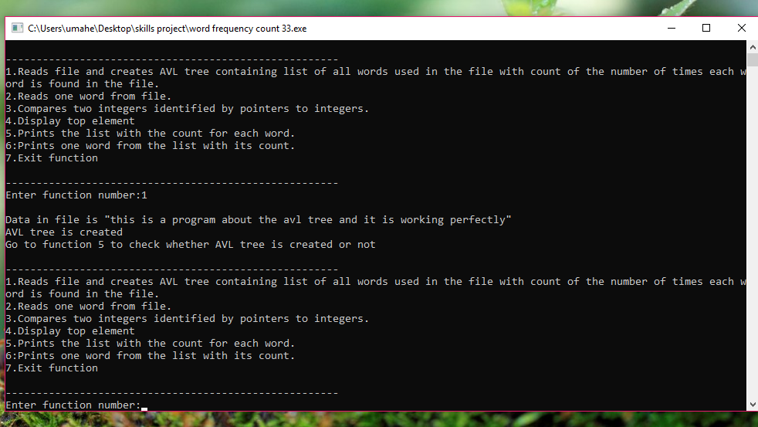

Slide 36
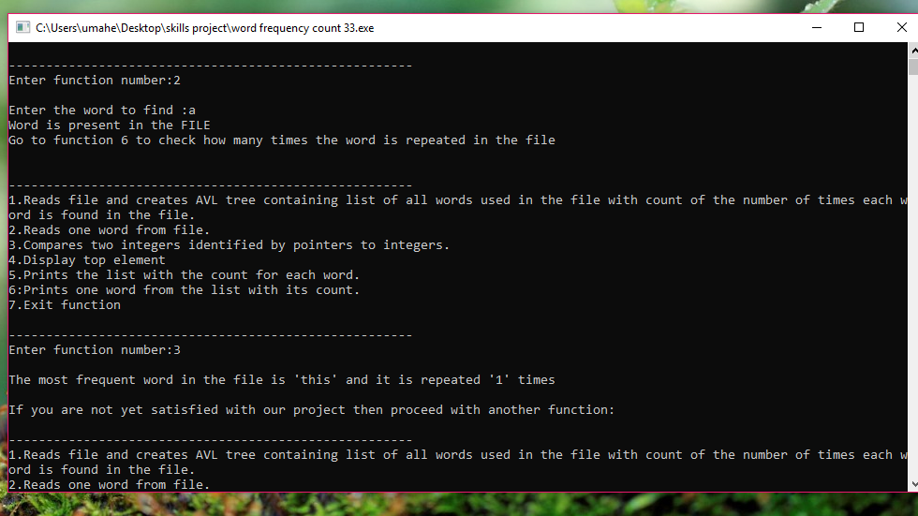

Slide 37
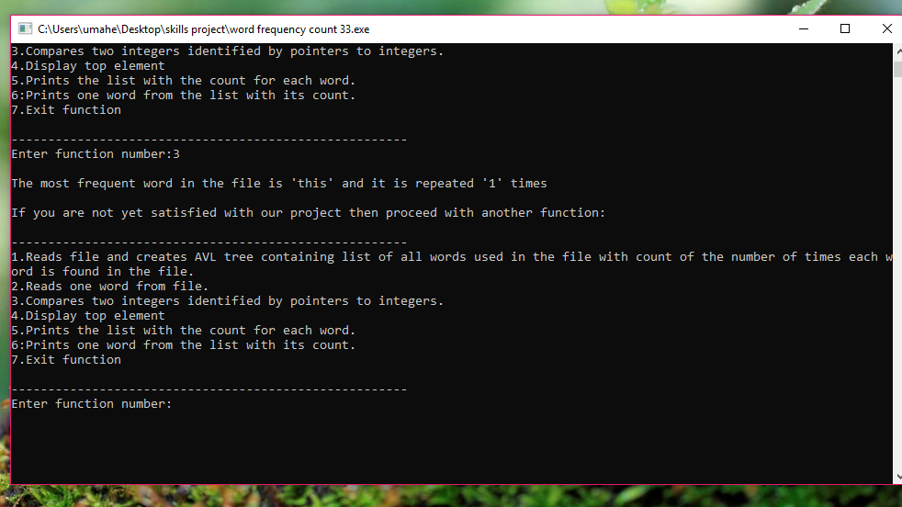

Slide 38
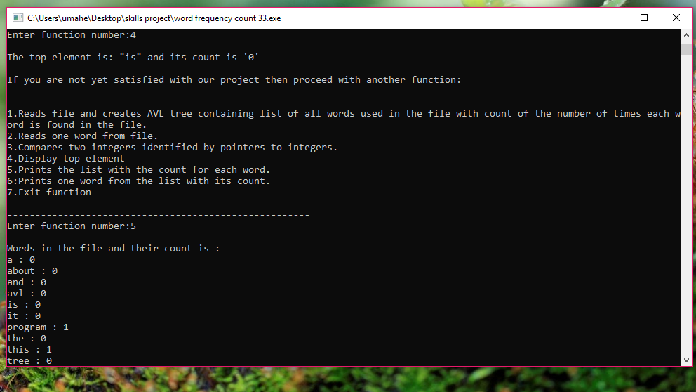

Slide 39
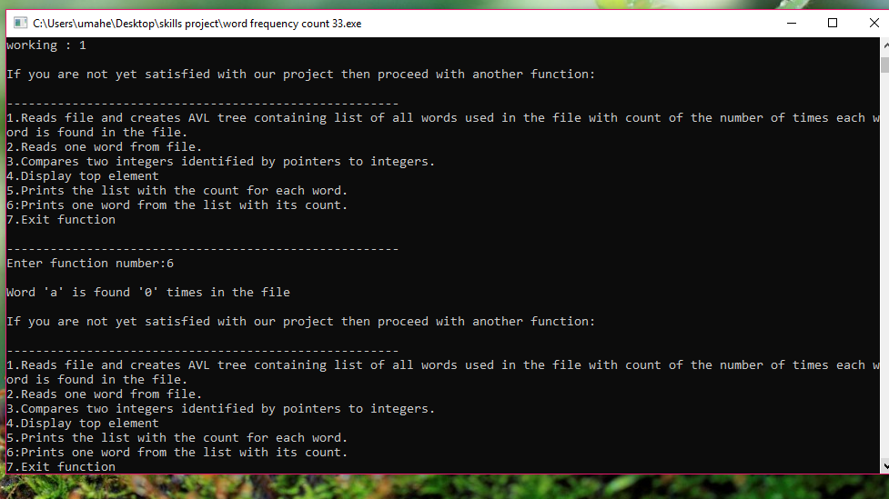

Slide 40
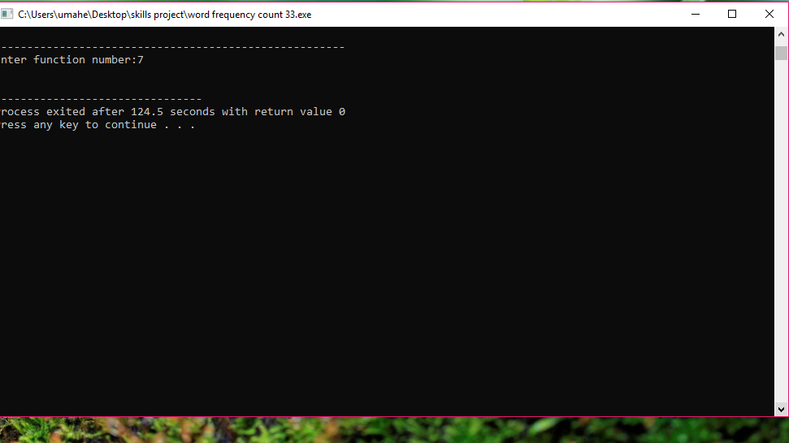

Slide 41
END OF PROJECT

Slide 42


